Slide 1

October 2, 2019

Slide 2




Acknowledgements & Sponsors

Slide 3
Important Points
Emergency exits
Feedback
We’re in a borrowed space, please clean up after yourself

Slide 4
Q&A
Unless quick, hold questions until the end
Please phrase your question in a form of a question
Try to keep questions to 30 seconds or less
Avoid long statements or monologues
There will be time for open discussions after Q&A

Slide 5
PyData Code of Conduct
http://pydata.org/code-of-conduct.html

Slide 6
Quick Icebreaker

Slide 7
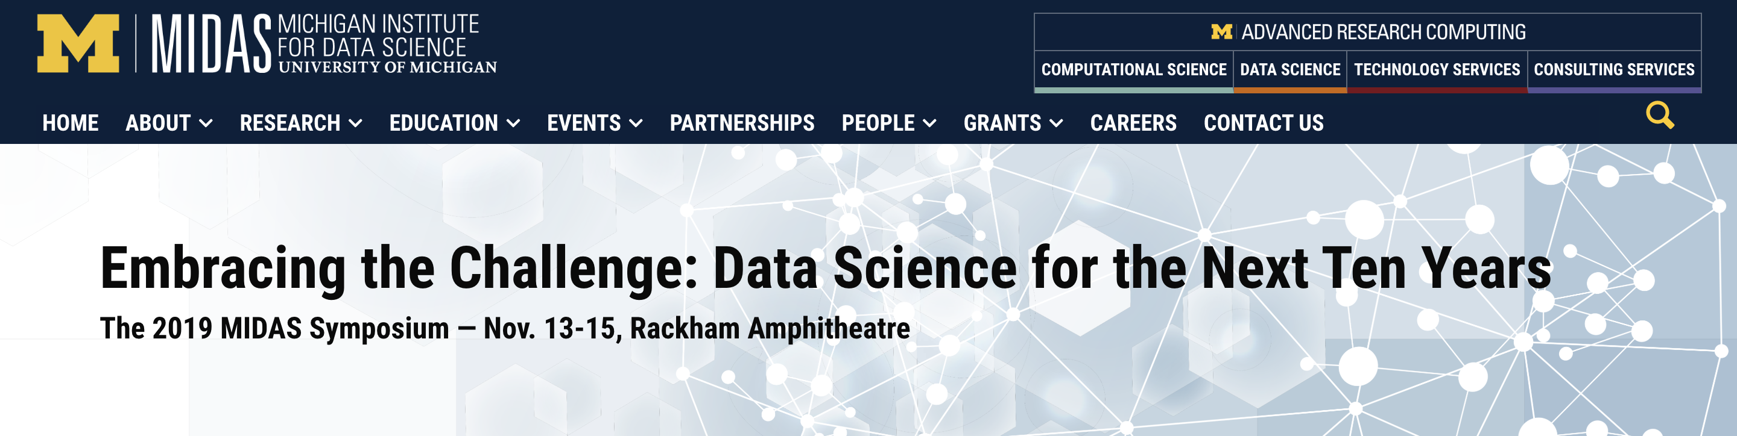
This Month in Data Science
MIDAS Symposium November 13-15, 2019
https://midas.umich.edu/2019-symposium/
Notes:
http://www.sciencemag.org/news/2018/12/google-s-deepmind-aces-protein-folding

Slide 8

This Month in Data Science
December 3-5, 2019
https://pydata.org/la2019/
Notes:
http://www.sciencemag.org/news/2018/12/google-s-deepmind-aces-protein-folding

Slide 9
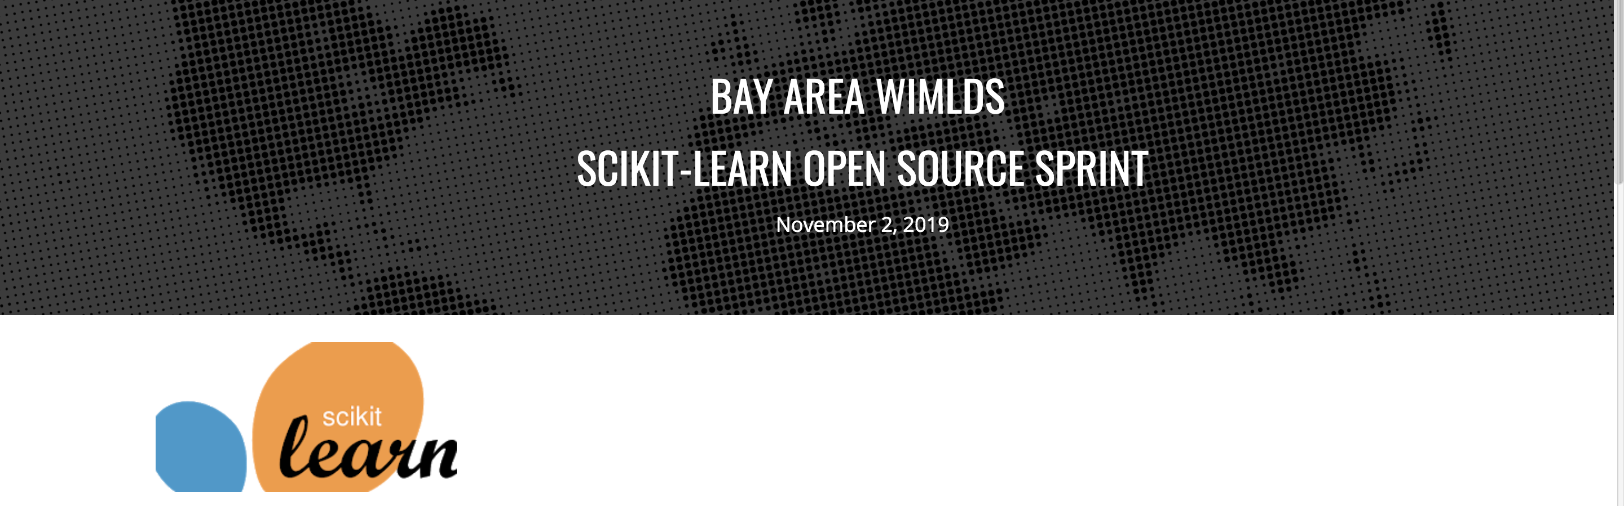
This Month in Data Science
November 2, 2019
https://sites.google.com/view/bay-area-wimlds-2019-sprint
Notes:
http://www.sciencemag.org/news/2018/12/google-s-deepmind-aces-protein-folding

Slide 10

Next Event
Who: Reshama Shaikh
What: Community Building: The Good and Bad
When: Wednesday, November 13th, 2019 (6:00pm)

Slide 11
Community Announcements?

Slide 12
October 2, 2019

Slide 14
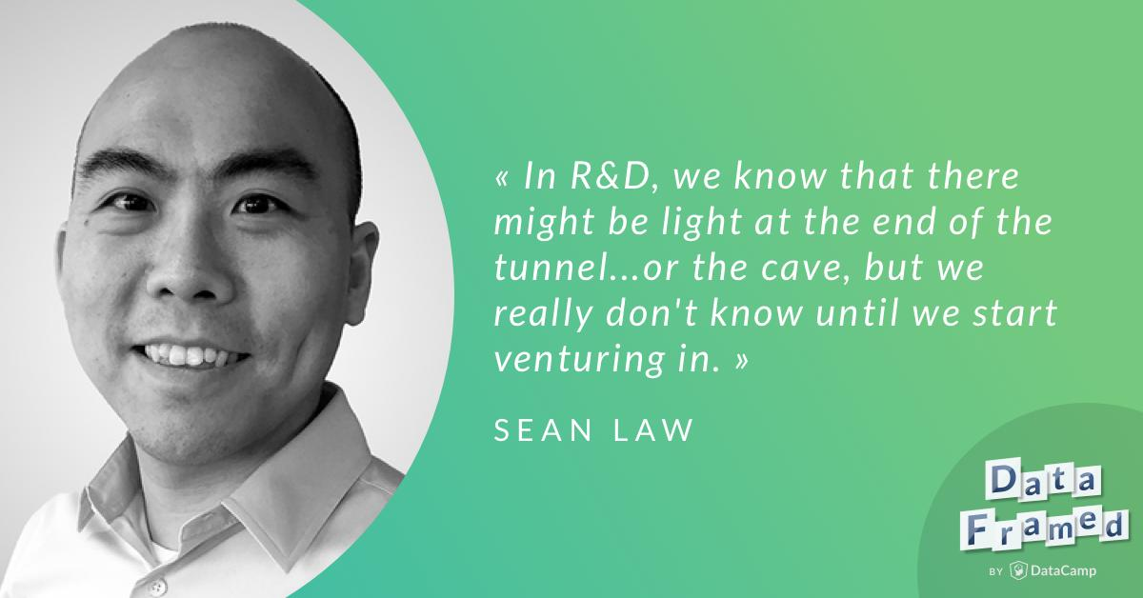
This Month in Data Science
DataFramed Podcast
https://www.datacamp.com/community/podcast/data-science-at-td-ameritrade
Notes:
http://www.sciencemag.org/news/2018/12/google-s-deepmind-aces-protein-folding

Slide 15
Researcher Developer Engineer Data Scientist
jobs.tdameritrade.com

